Slide 1
Technical Analysis Volatility Game
Presenter : Kanak Kr Jain

Slide 2
What is a trend?

Slide 3
“A trend is a general drift or tendency in a set of data.
All measurements of trend involve taking a current reading and a historical reading and comparing them.
If the current reading is higher than the historical reading, we have an up-trend.
If lower, we have a down-trend.
In the improbable event of an exact match, we have a sideways trend.
As per Ed Seykota

Slide 4
Interpreting OHLC Charts
An OHLC chart shows the open, high, low, and close price for a given period.
It can be applied to any timeframe.
The vertical line represents the high and low for the period, while the line to the left marks the open price and the line to the right marks the closing price. This entire structure is called a bar.
When the close is above the open, the bar is often colored black. When the close is below the open the bar is often colored red.

Slide 5
Dow Theory:
1. The market discounts everything
2. There are three kinds of market trends( One year, 3 week to 3 month and finally less than 3 week trend)
3. Primary trends have three phases.( Accumulation , Distribution and panic phases)
4. Indices must confirm each other
5. Volume must confirm the trend.
6. Trends persist until a clear reversal occurs

Slide 6
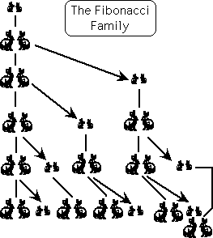
A Fibonacci number follows the sequence 0, 1, 1, 2, 3, 5, 8, 11, etc. where the each number is the sum of the two numbers before it.

Slide 7
What Is Relative Strength Index?
The relative strength index (RSI) is a momentum indicator that measures the magnitude of recent price changes to evaluate overbought or oversold conditions in the price of a stock or other asset. The RSI is displayed as an oscillator (a line graph that moves between two extremes) and can have a reading from 0 to 100. The indicator was originally developed by J. Welles Wilder Jr. and introduced in his seminal 1978 book, New Concepts in Technical Trading Systems

Slide 8
Traditional interpretation and usage of the RSI is that values of 70 or above indicate that a security is becoming overbought or overvalued and may be primed for a trend reversal or corrective pullback in price. An RSI reading of 30 or below indicates an oversold or undervalued condition.
The very first calculations for average gain and average loss are simple 14-period averages:
First Average Gain = Sum of Gains over the past 14 periods / 14.
First Average Loss = Sum of Losses over the past 14 periods / 14
The second, and subsequent, calculations are based on the prior averages and the current gain loss:
Average Gain = [(previous Average Gain) x 13 + current Gain] / 14.
Average Loss = [(previous Average Loss) x 13 + current Loss] / 14.

Slide 9
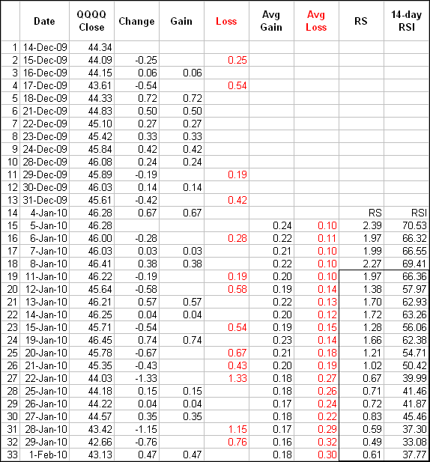

Slide 10
http://www.moneycontrol.com/nifty/nse/nifty-live

